Slide 1
TNT Vision 24-1 최종 성과공유회
문학준
Gloriel621@g.skku.edu
2024/06/25

Slide 2
Contents
스터디
Multi-Modal
Mamba
Style Transfer
프로젝트(DNA HERO, Multi-Modal Mamba Style Transfer)

Slide 3
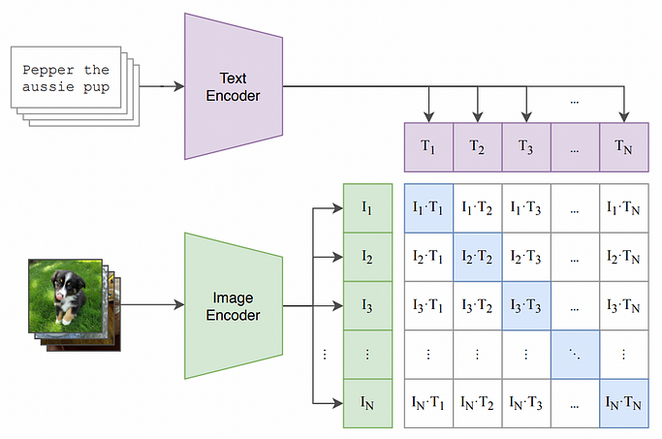
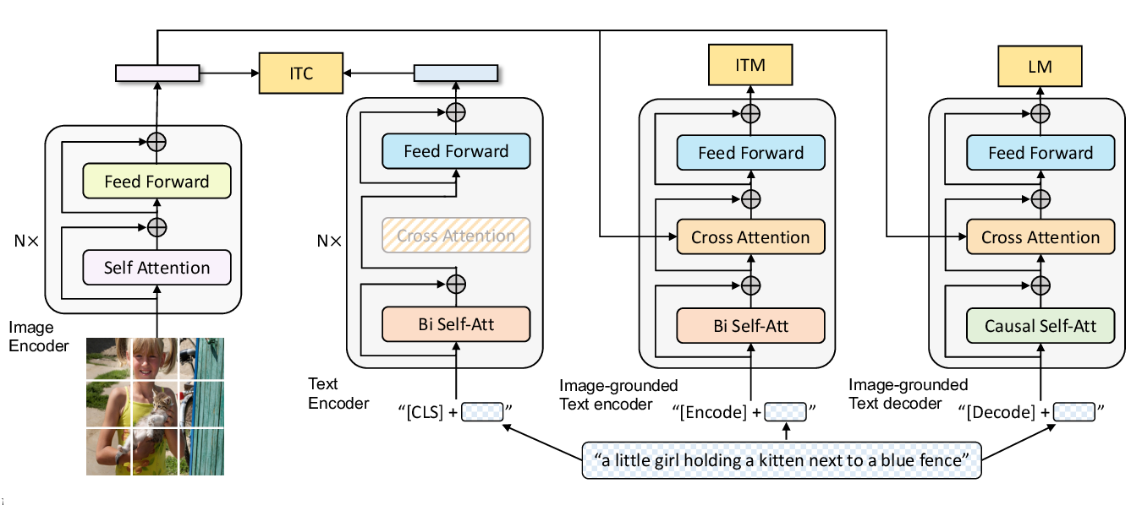

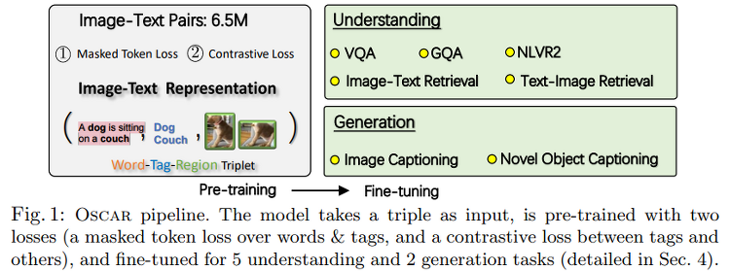
멀티모달 스터디
CLIP
BLIP
DALL-E
OSCAR

Slide 4
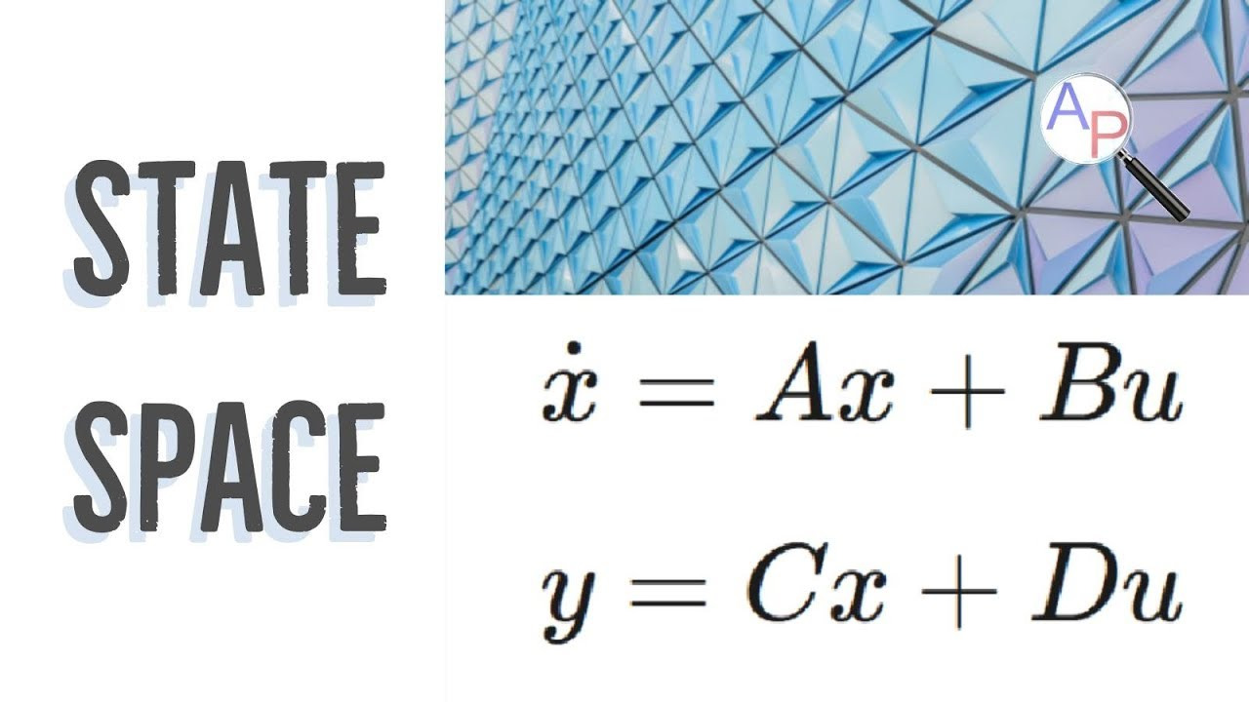
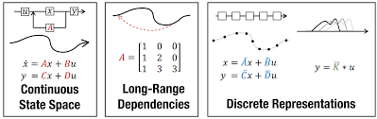
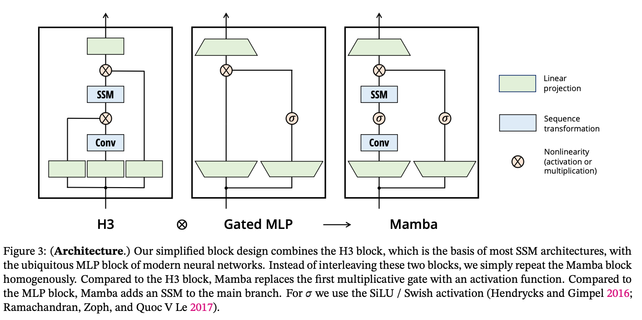
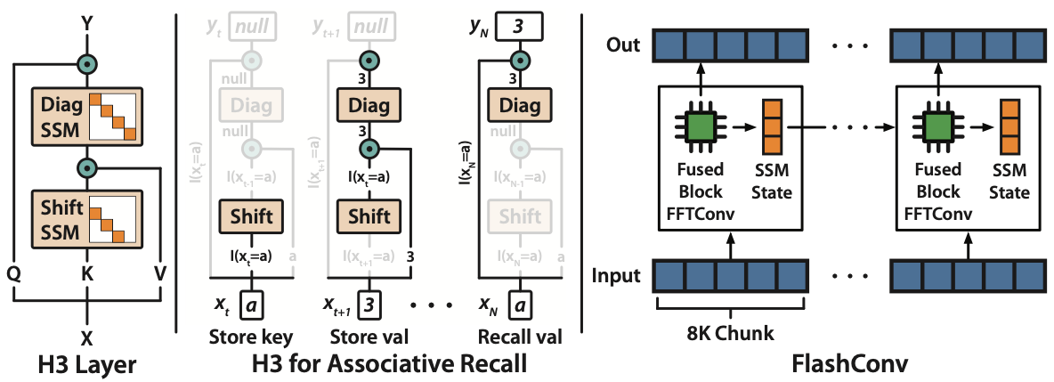
Mamba
State Space Model (SSM)
Structured State Space for Sequence Modeling (S4)
H3
Mamba (S6)

Slide 5
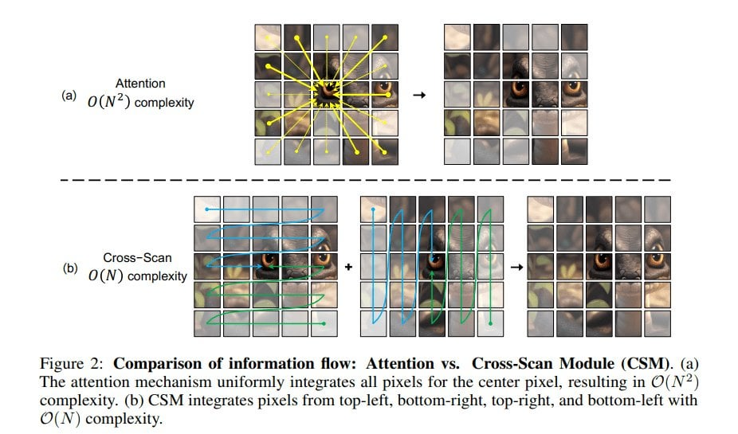
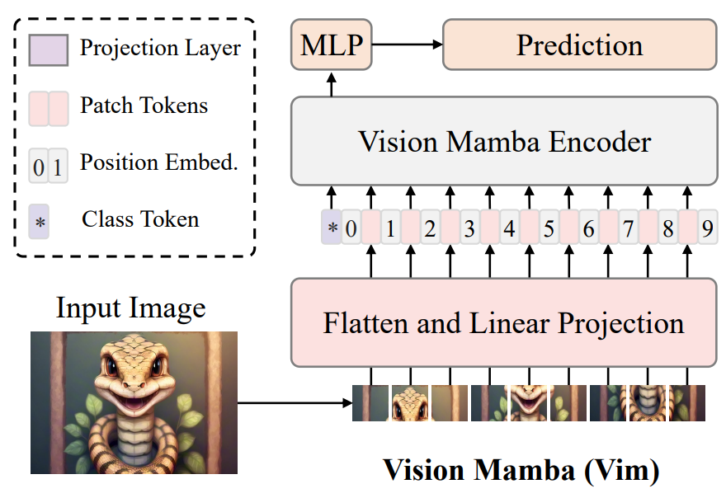
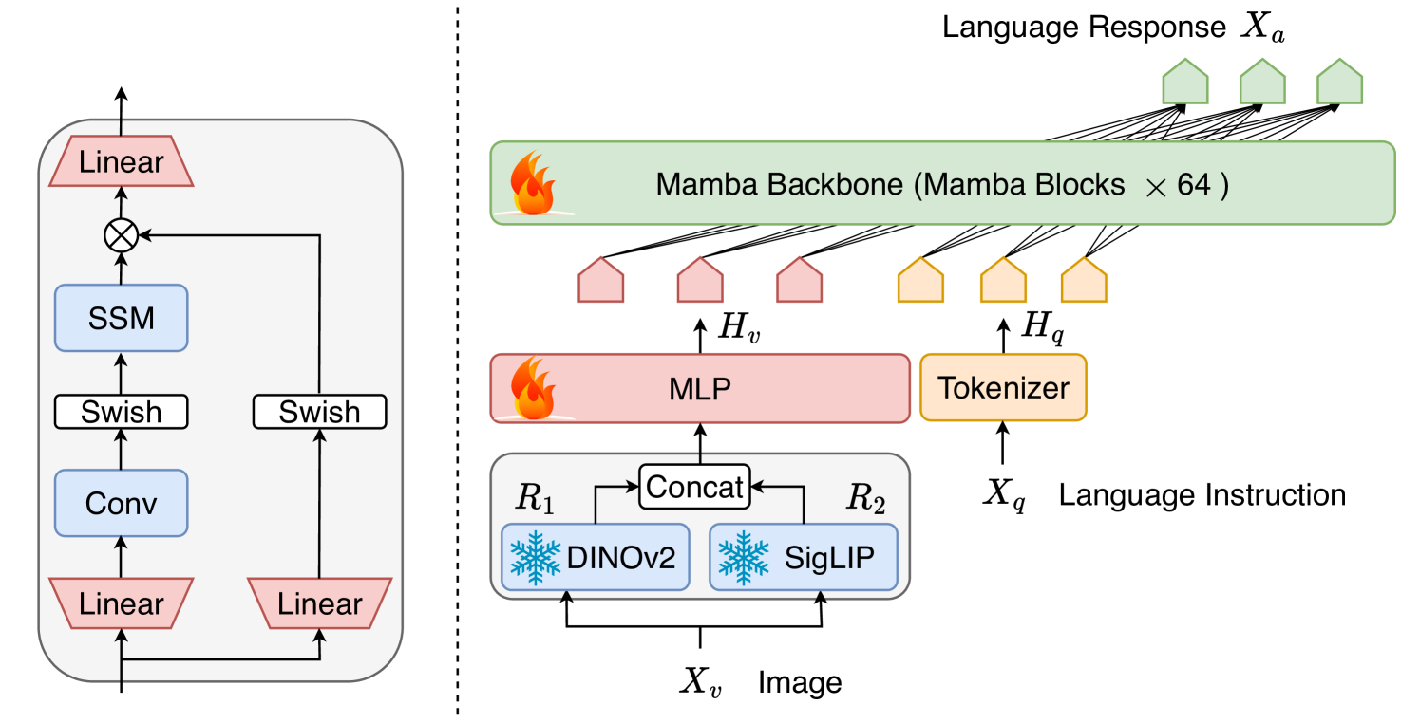
Mamba Application
VMamba
Vision Mamba
Cobra

Slide 6
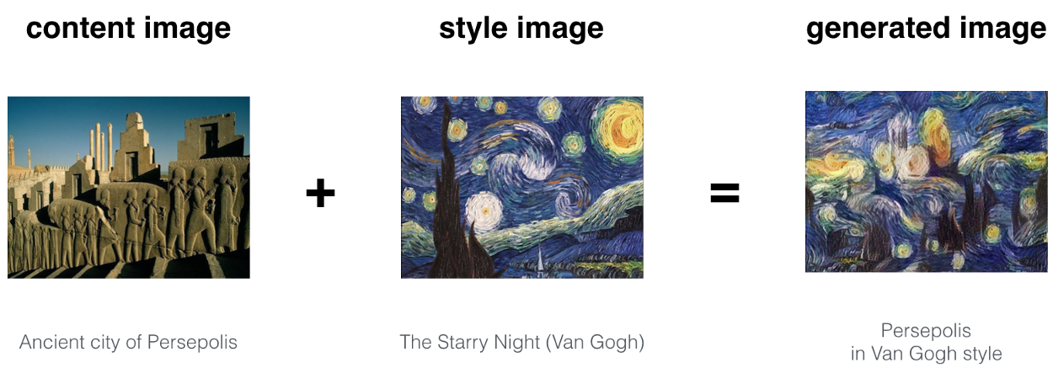
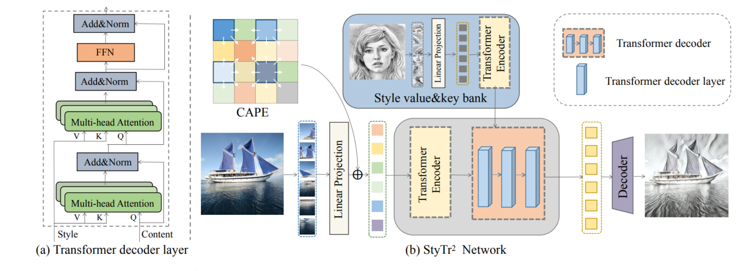
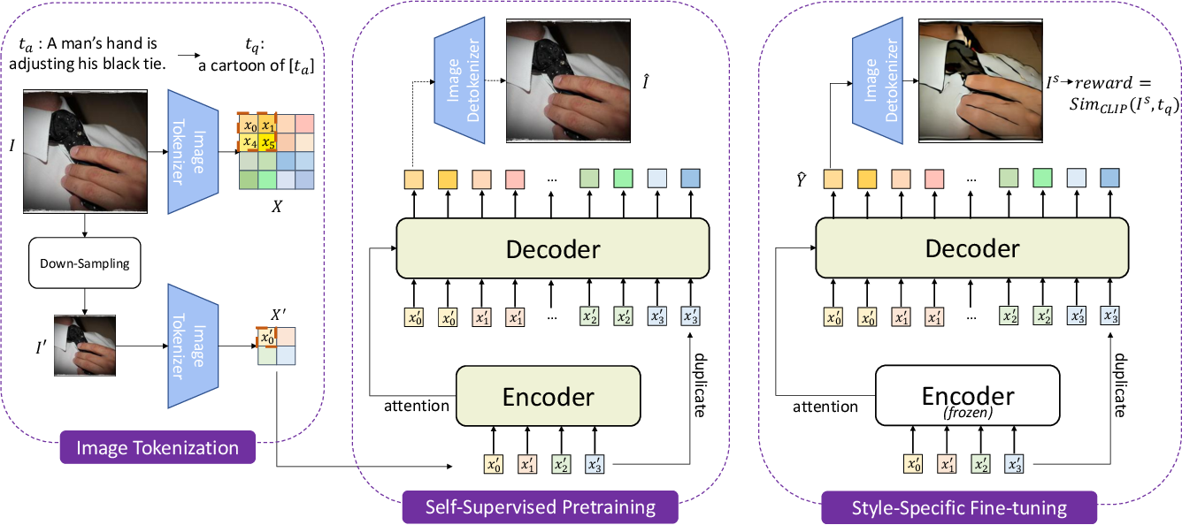
Style Transfer
Vanilla Style Transfer (2016)
StyTR-2 (2022)
StylerDALLE (2023)

Slide 7
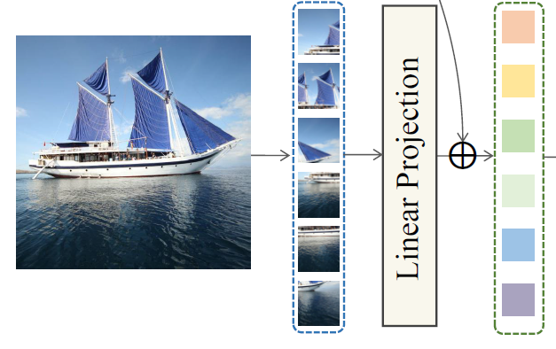
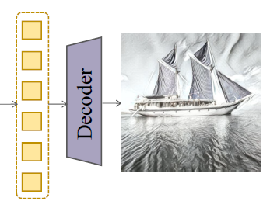
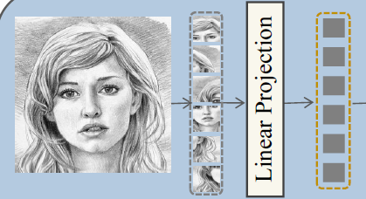
Mamba Style Transfer
VMamba Encoder
VMamba Decoder
VSS
Block
VSS
Block
Linear
VSS
Block
VSS
Block
Feature Concatenate

Slide 8
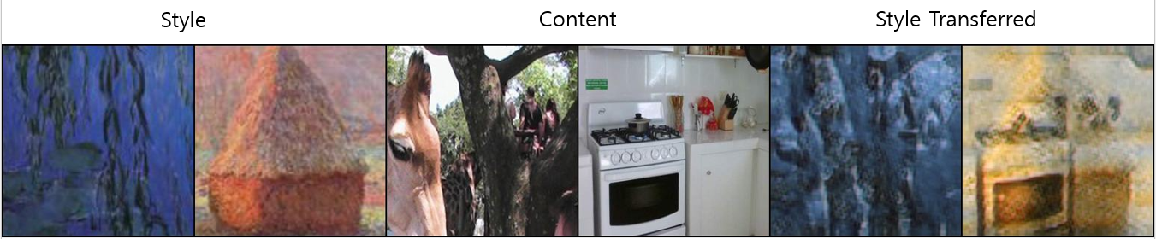
Mamba Style Transfer

Slide 9
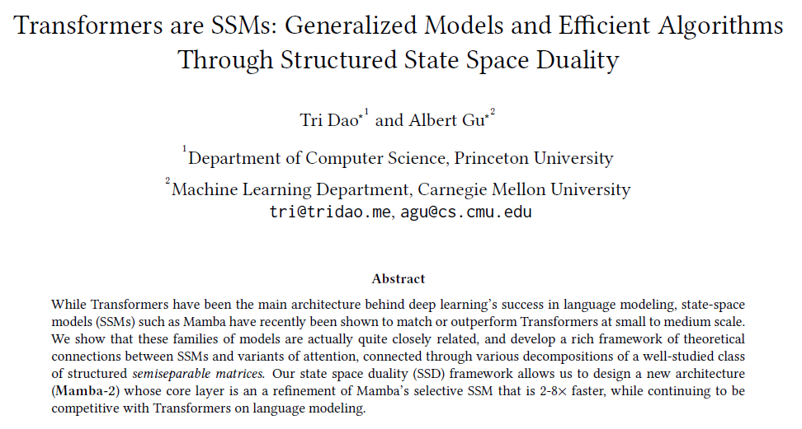
Mamba-2 (2024-05-31)
Paper: https://arxiv.org/abs/2405.21060
Code: https://github.com/state-spaces/mamba

Slide 10
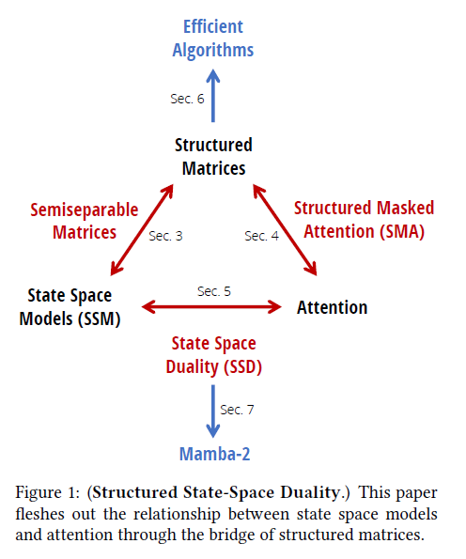
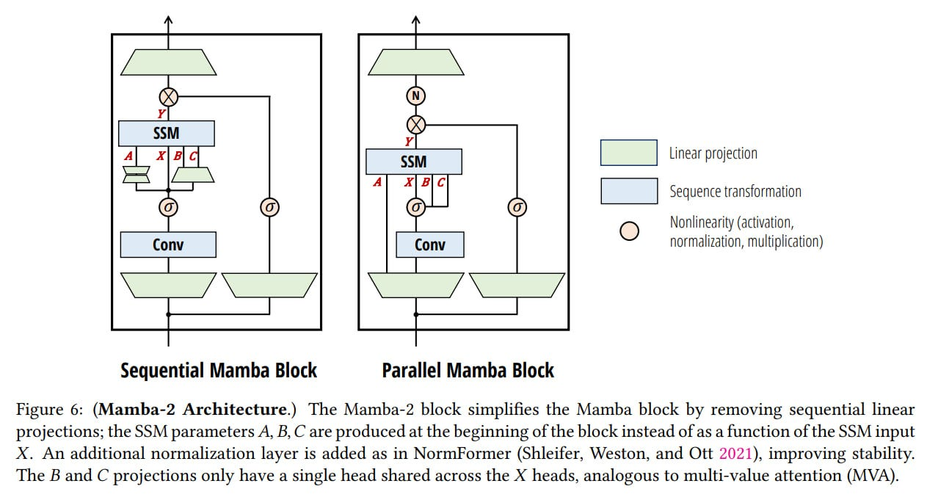
Mamba-2

Slide 11


